Slide 1


Applied Virtual Networks
COMP 4912
Instructor: Dawood Sajjadi
PhD, SMIEEE, CISSP
ssajjaditorshizi@bcit.ca
Winter-Spring 2025
Week #3

Slide 2
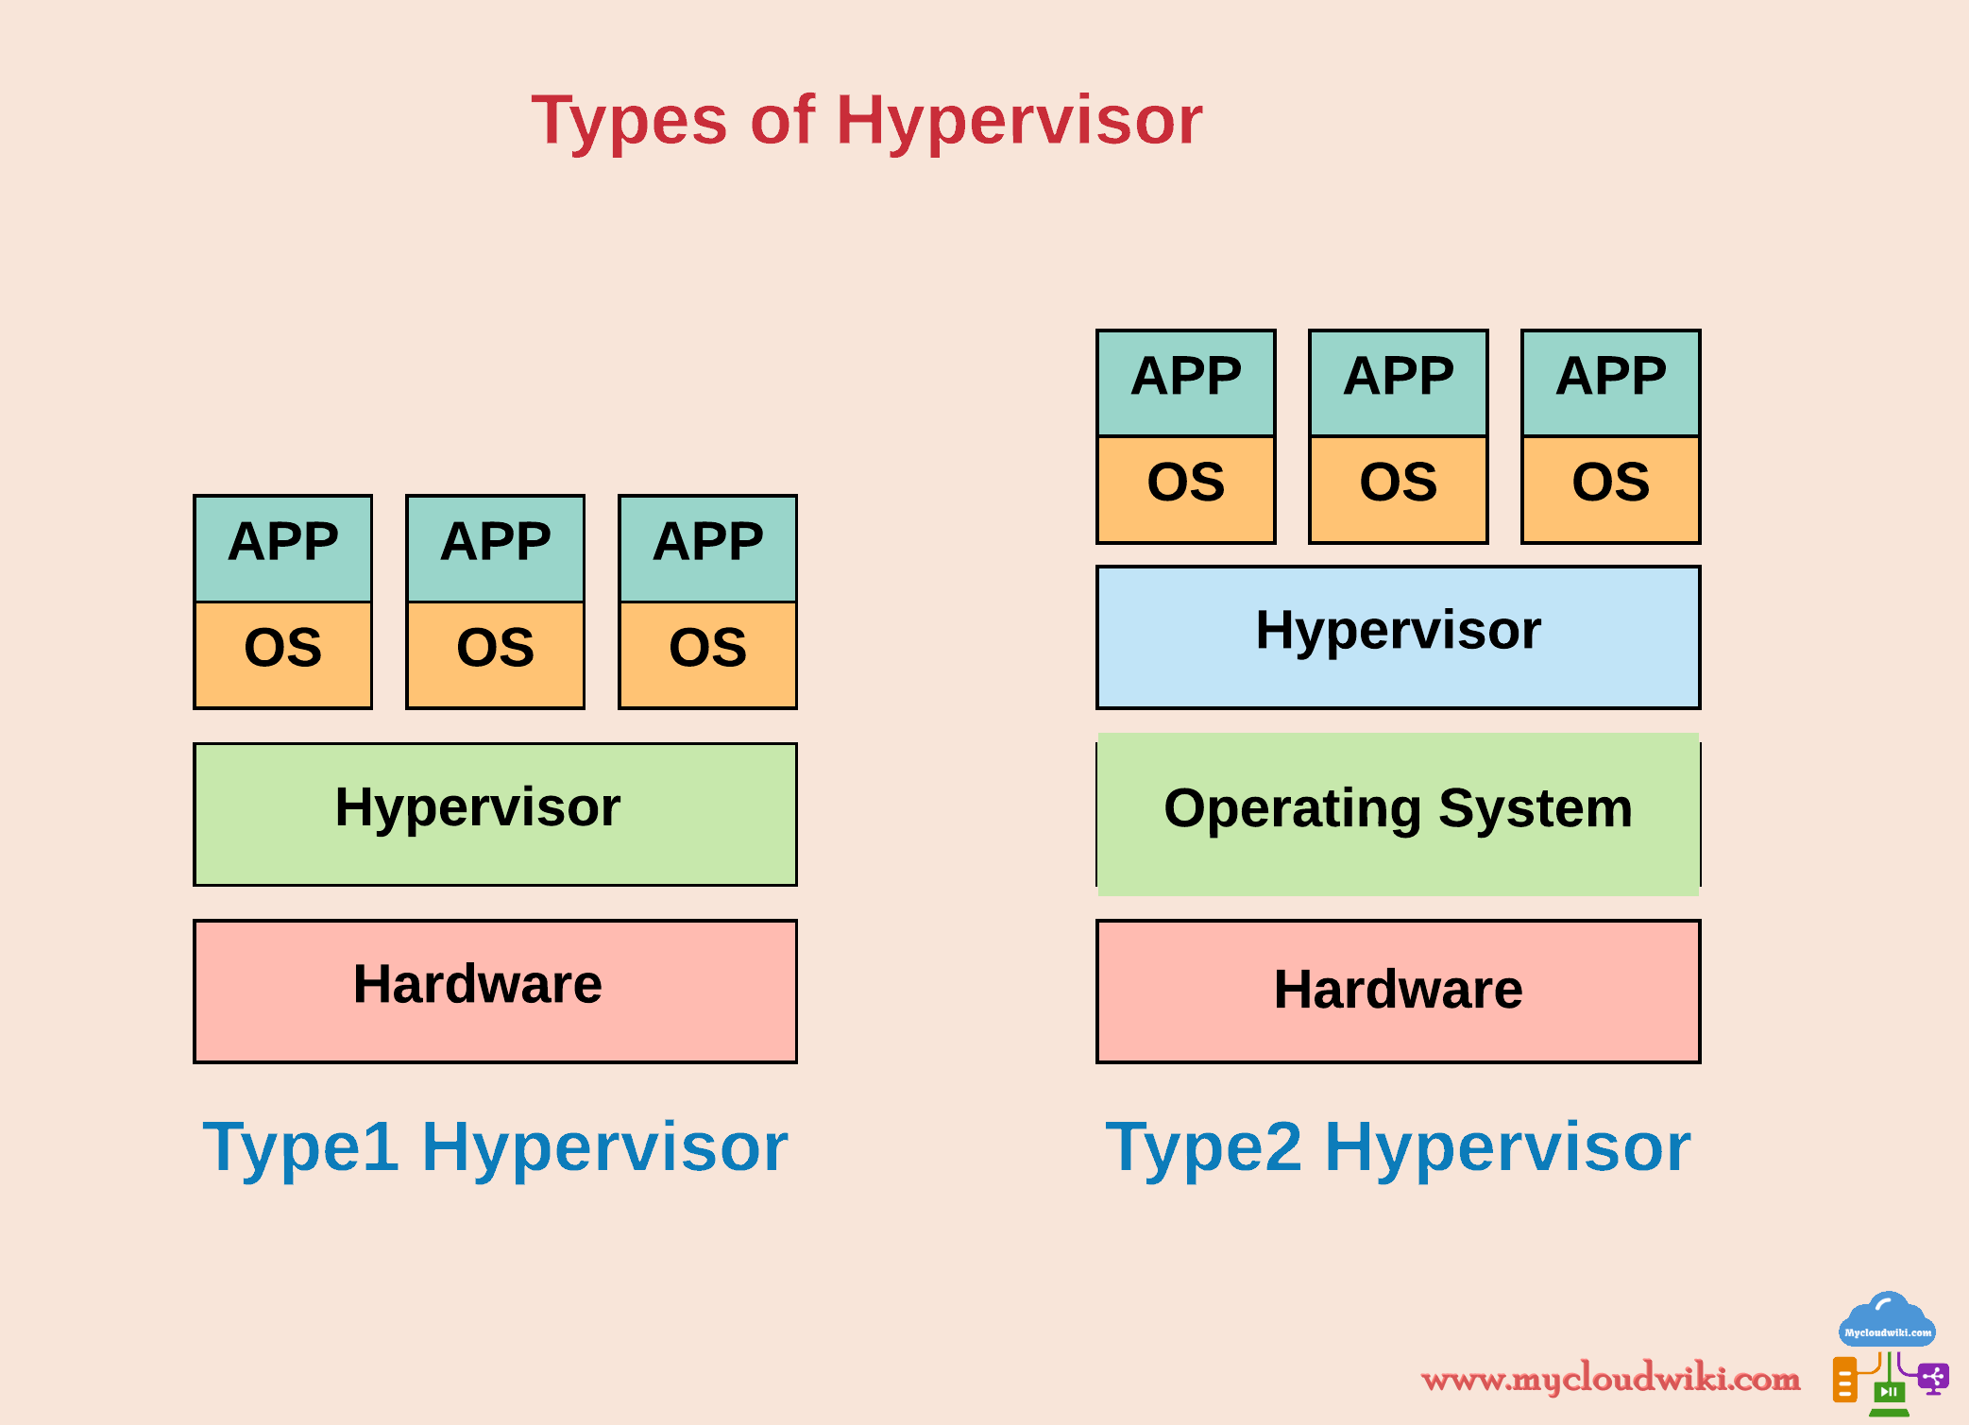

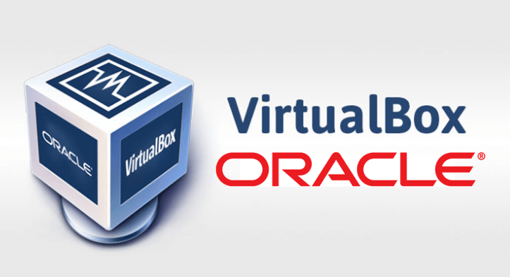

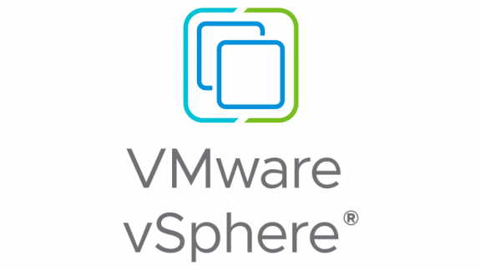


Virtual Machines
RECAP
Types of Hypervisors
Type-1
Type-2
Bare-metal
Run guest-OS on top of host-OS

Slide 3
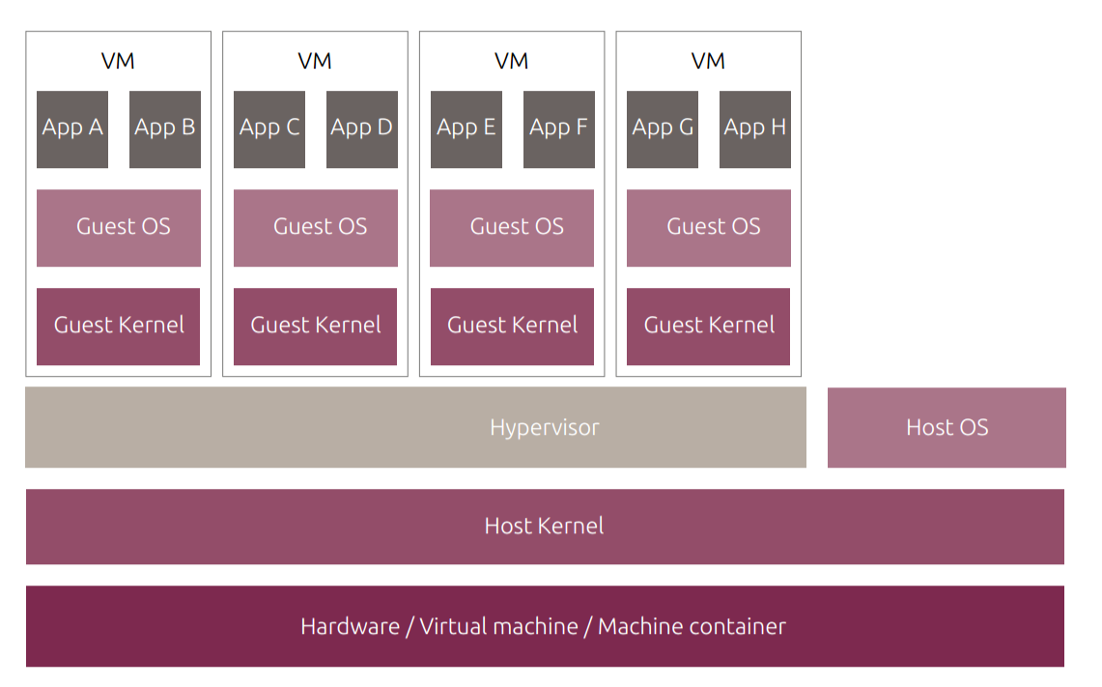
Virtual Machines
RECAP

Slide 4
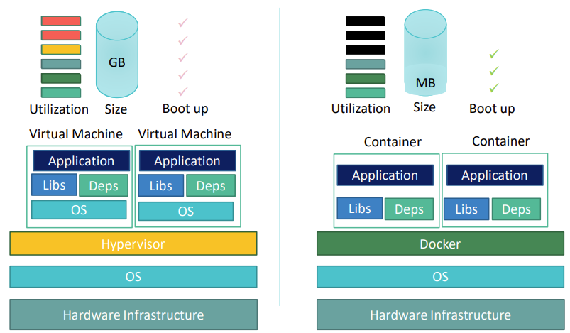
Containers vs Virtual Machines
RECAP
Created from Container images
With the same container image, you can reproduce as many containers as you wish.
Think about the image as the recipe, and the container as the cake.
You can make as many cakes as you’d like with a given recipe.

Slide 5

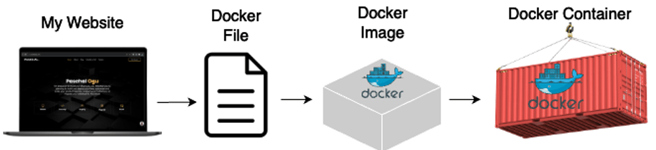
What is Docker and Why use it?
RECAP
Docker Ecosystem
from DockerHub
Container
A platform for running Containers
Image file
Container
A single file with all the required libraries, package and configuration needed to run a program/app.
Container
Docker Server
Docker Compose
Instance of an image that runs a program (process)
Docker Machines
Docker Client
Docker Hub
Docker Images
Docker makes it very easy to install and run applications and programs without being worrying about software dependencies.
Notes:
The advantage of using containers is that they only virtualize the operating system and do not require dedicated piece of hardware because they share the same kernel of the hosting system. Containers give the impression of a separate operating system however, since they're sharing the kernel, they are much cheaper than a virtual machine.

Slide 6
Docker Commands
RECAP
Running a Simple Nginx Web Server Using Docker
$ docker --version
$ docker search nginx
$ docker pull nginx
$ docker image ls
$ docker run --name nginx-web-server –d –p 8000:80 nginx
$ docker ps
$ docker ps -s
$ docker logs nginx-web-server
$ docker exec -it nginx-web-server /bin/sh
$ docker stop nginx-web-server
$ docker start nginx-web-server
$ docker rm nginx-web-server
$ docker rmi nginx
Search for an image name
Pull an image from Docker Hub
List images pulled to your laptop
Run a container from an image
List running containers
Displays approximate size of containers
Check container logs
Access a shell inside a sunning container
Stop a running container
Start a stopped container
Remove a container
Remove an image
Notes:
Docker Engine: Creates, ships and runs Docker containers deployable on a physical or virtual, host locally, in a datacenter or cloud service provider. Registry Service (Docker Hub or Docker Trusted Registry): Cloud or server-based storage and distribution service for your images
docker run: Starts a new Docker container based on a specified image.--name nginx-web-server: Assigns the container a name (nginx-web-server) for easier identification and management.-d: Runs the container in detached mode, meaning it runs in the background.-p 8000:80: Maps port 8000 on the host machine to port 80 inside the container.Port 80 is the default HTTP port used by Nginx.
By doing this, you can access the web server on your host machine at http://localhost:8000.
nginx: Specifies the Docker image to use, in this case, the official Nginx image from Docker Hub.

Slide 7
Learning Outcomes of Week #3
Understanding YAML language and use it to compose Dockers.
Explain How Kernel-based Virtual Machine (KVM) works?
Describe the difference between Application and System Containers.
Get Familiar with Virsh and its difference with KVM/Qemu.
Understanding LXD/LXC to run VMs and Containers.

Slide 8
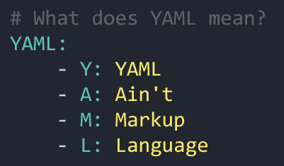
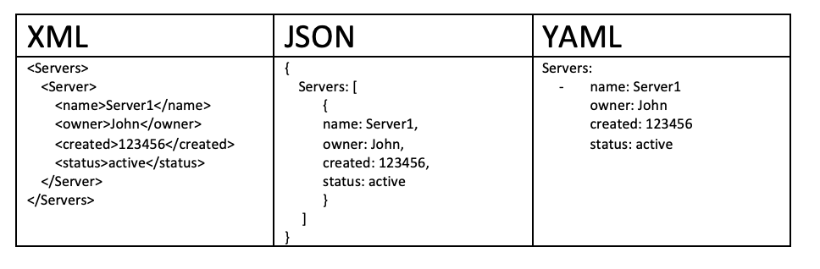
YAML Intro
YAML is a human-readable data-serialization format.
Commonly used for configuration files in Cloud Applications.
YAML is designed to be friendly to people working with data and achieves "unique cleanness" by minimizing the use of structural characters, allowing the data to appear in a natural and meaningful way.
YAML achieves easy inspection of data's structures by using indentation-based scoping (similar to Python).

Slide 9
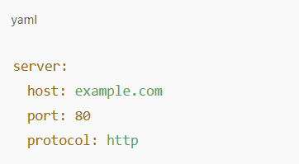
YAML Intro
Key-Value Pairs: Data is represented as key-value pairs. (key: value)
Indentation: Indentation is important! It uses spaces (not tabs).
Lists: Use dashes (-) for lists.
easy to
read,
write and hierarchical structure.
server is a key, and its value is another set of key-value pairs.
host, port, and protocol are nested under server.

Slide 10
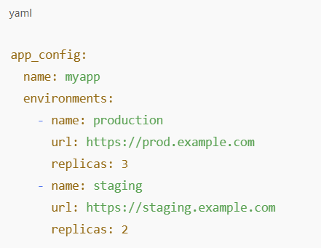
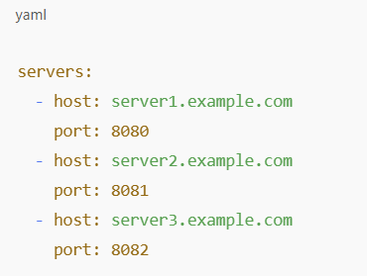
YAML Intro
Nested Data Structures
Using Lists in YAML
Lists are represented with dashes (-).
Each item in the list can have multiple key-value pairs.
YAML allows nesting of keys and lists.
environments is a list with dictionaries for each environment

Slide 11
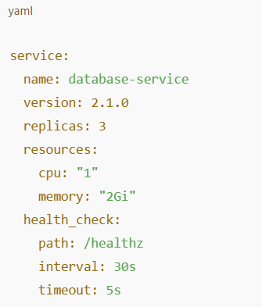
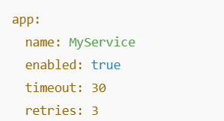
YAML Intro
Scalers and Data Types
Example: Service Configuration in YAML
Strings: "example" or without quotes.
Booleans: true, false.
Numbers: 100, 3.14.
Null: null or ~.
Used for configuring the service in a Kubernetes or Docker context.
Defines replicas, resource limits, and health check intervals

Slide 12
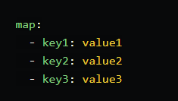
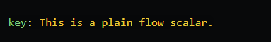
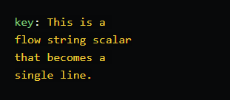
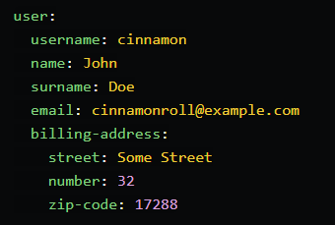
YAML Intro
Mapping
Flow String Scalars
Block Mapping
Notes:
Flow scalars are a way of representing strings that can span multiple lines. They use quotes and escape sequences to indicate the structure and boundaries of a string. They are more compact and readable than block string scalars, but they are more limited in escaping support. Flow scalars are defined by starting with a colon (:), followed by the string content. The string content can be indented to any level, but the indentation will be ignored in the output.

Slide 13
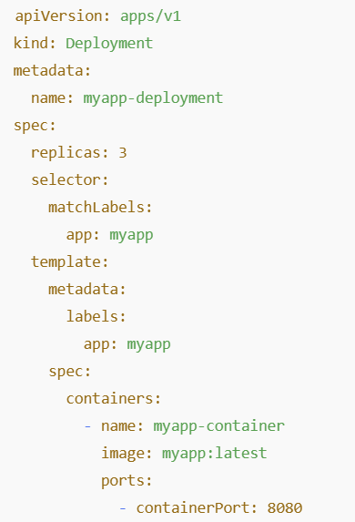
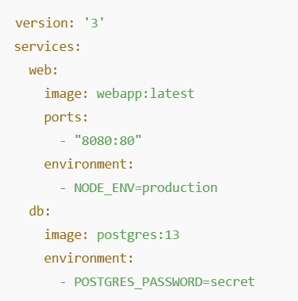
YAML Intro
YAML with Kubernetes
Using YAML in CI/CD
A docker-compose.yml example for defining services in a CI/CD pipeline.
Specifies which containers to run and how they communicate
YAML used to define a Kubernetes Deployment.
Defines how many replicas, the container image, and port configuration.

Slide 14
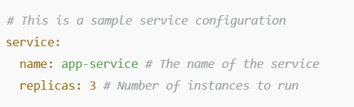
YAML Intro
Commenting in YAML
Adding Comments in YAML
Comments begin with # and continue to the end of the line.
Can be placed anywhere, but should not appear after a value.
YAML Best Practices
Use two spaces for indentation (no tabs).
Always start lists with -.
Be mindful of spaces after : in key-value pairs.
Use quotes for strings with special characters or spaces.
Keep YAML files small and readable, avoid deep nesting where possible.

Slide 15
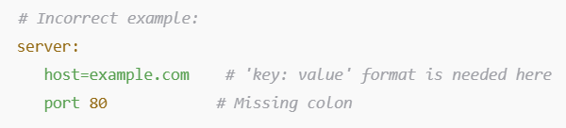
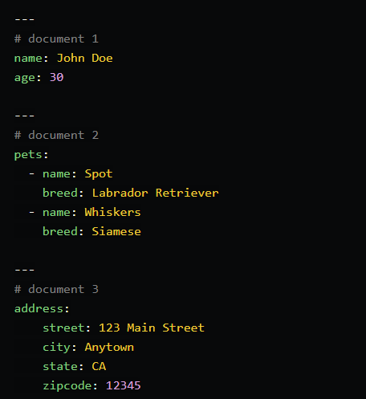
YAML Intro
Common mistakes in YAML
Using tabs instead of spaces.
Forgetting to indent properly.
Using incorrect key-value formatting.
A single YAML file can have more than more than one document. Each document can be interpreted as a separate YAML file which means multiple documents can contain the same/duplicate keys. A YAML file with multiple documents would look like below, where each new document is indicated by ---.

Slide 16
Docker Compose and YAML
Docker Compose is a tool for defining and managing multi-container Docker applications.
It uses a YAML file to configure application services.
Simplifies multi-container setups
Enables service orchestration
Allows network and volume configuration
Provides portability for application environments
Compose files are written in YAML format and follow a standard structure:
version: Specifies the Compose file version
services: Defines individual container services
volumes: Configures persistent storage
networks: Specifies custom networking

Slide 17
Docker Compose and YAML
Setup a web server using Nginx and a static HTML website served from a local directory.
This example demonstrates key Docker Compose concepts like defining services, volumes, and ports.
docker-compose.yml
Index.html
version: '3.9'
services:
web:
image: nginx:latest
ports:
- "8000:80" # Map port 8000 on the host to port 80 in the container
volumes:
- ./html:/usr/share/nginx/html:ro # Mount the local html/ directory to Nginx's web root
<!DOCTYPE html>
<html lang="en">
<body>
<h1>Welcome to My Simple Website!</h1>
<p>Served using Docker Compose with Nginx.</p>
</body>
</html>
$ docker-compose up -d --build
Access your website via http://localhost:8000
Notes:
docker-compose up --build

Slide 18
Docker Compose and YAML
Setup up a Load Balancer with multiple backend web servers.
This demonstrates how Docker Compose can manage service communication, networking, and scalability.
We need to create:
a HAProxy load balancer that distributes traffic.
Two backend web servers running Nginx, both serving the same content.
Project Structure
load-balancer/
├── docker-compose.yml
├── haproxy/
│ ├── haproxy.cfg
├── web1/
│ └── index.html
├── web2/
│ └── index.html
<!DOCTYPE html>
<html lang="en">
<head>
<meta charset="UTF-8">
<meta name="viewport" content="width=device-width, initial-scale=1.0">
<title>Web Server 1</title>
</head>
<body>
<h1>Welcome to Web Server 1</h1>
</body>
</html>
web1/index.html
web2/index.html
haproxy.cfg
<!DOCTYPE html>
<html lang="en">
<head>
<meta charset="UTF-8">
<meta name="viewport" content="width=device-width, initial-scale=1.0">
<title>Web Server 2</title>
</head>
<body>
<h1>Welcome to Web Server 2</h1>
</body>
</html>
frontend http_front
bind *:80
default_backend http_back
backend http_back
balance roundrobin
server web1 web1:80 check
server web2 web2:80 check

Slide 19

Docker Compose and YAML
version: '3.9'
services:
haproxy:
image: haproxy:latest
volumes:
- ./haproxy/haproxy.cfg:/usr/local/etc/haproxy/haproxy.cfg:ro
ports:
- "8000:80" # Expose HAProxy on port 8000
depends_on:
- web1
- web2
networks:
- lb_network
web1:
image: nginx:latest
volumes:
- ./web1:/usr/share/nginx/html:ro
networks:
- lb_network
web2:
image: nginx:latest
volumes:
- ./web2:/usr/share/nginx/html:ro
networks:
- lb_network
networks:
lb_network:
The Compose file orchestrates the load balancer and the two backend web servers.
HA-Proxy LB
WebServer-1
WebServer-2
$ docker-compose up -d --build
$ docker-compose down
Notes:
Give a demo on this to the students in the class

Slide 20

Docker Compose and YAML
Interactive Demo
&
1

Slide 21
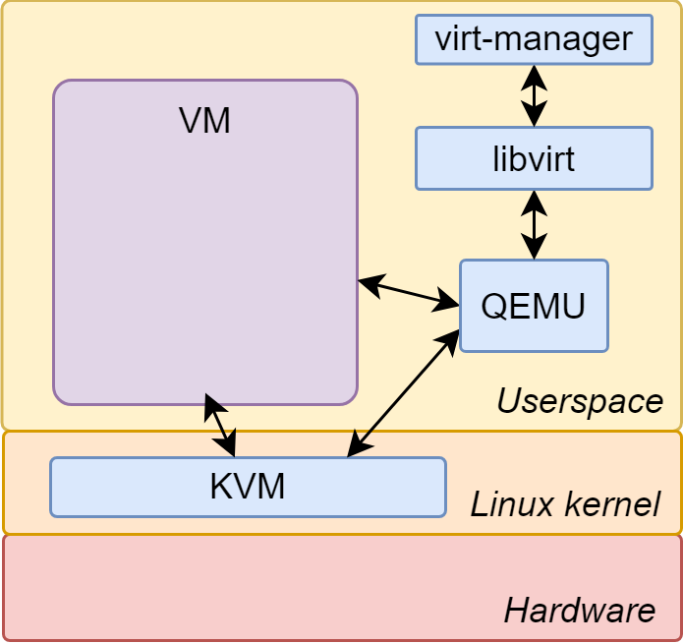
KVM (Kernel-based Virtual Machine)
KVM is a Linux kernel module that turns Linux into a Type-1 hypervisor, enabling full virtualization of hardware.
Key Features
Provides virtualization with hardware acceleration (Intel VT-x/AMD-V).
Can run full virtual machines (VMs) with different OS types (Linux, Windows, etc.).
Often paired with QEMU for device emulation and management.
Ideal for running resource-heavy applications and legacy OSes in isolated environments.
Better Performance, Scalability and Security.
QEMU (Quick Emulator) is an open-source emulator and virtualizer that can emulate different architectures (e.g., ARM, x86).
Key Features
Works alongside KVM to create virtual machines.
Can emulate a variety of processor architectures.
Useful for running VMs with non-x86 architectures, such as ARM-based VMs.

Slide 22
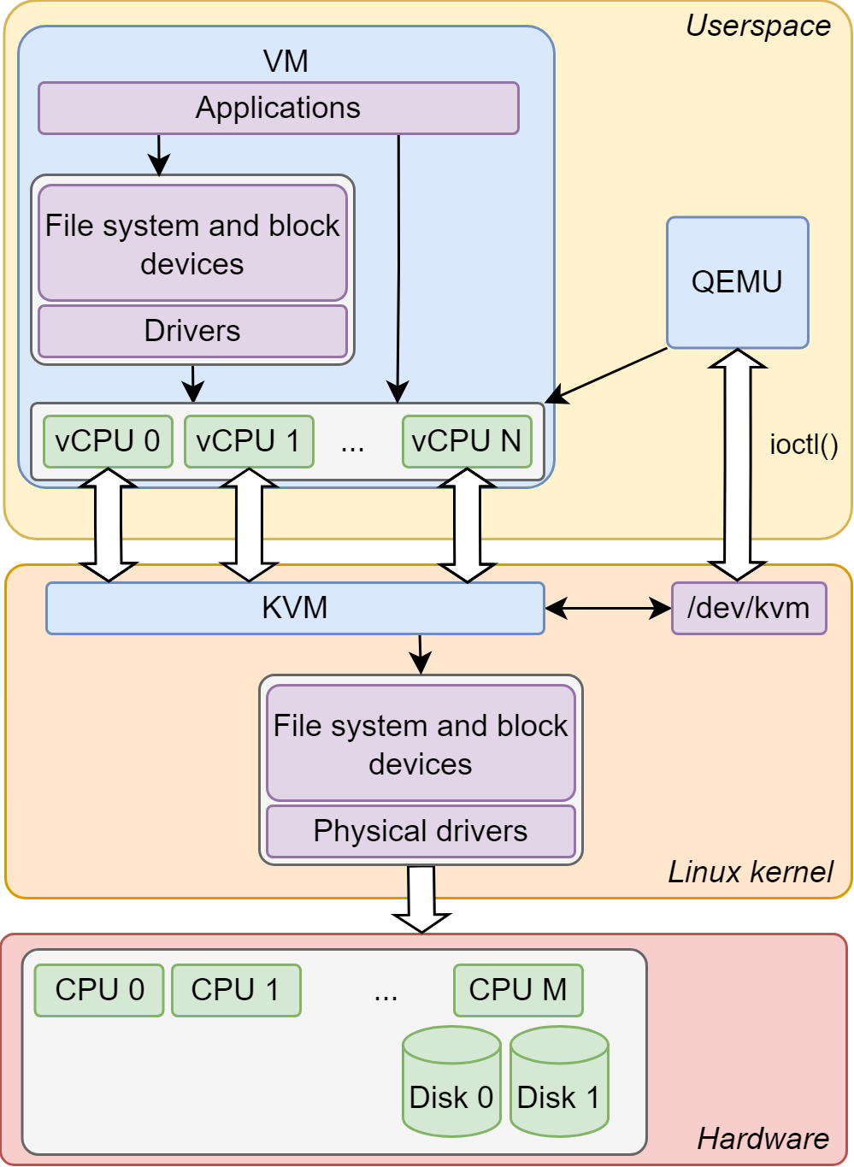
KVM (Kernel-based Virtual Machine)
KVM is the lowest component in the stack and as a Linux kernel module, interacts directly with the hardware.
It makes use of hardware-assisted virtualization supported by the CPU, in order to allow Hardware-based Full Virtualization.
QEMU sits above KVM and complements its functionality.
QEMU manages the processes of the guest systems and emulates devices being passed to them.
Libvirt is the library that is used in order to control QEMU and manage the Virtual Machines (VMs).
Notes:
KVM is the lowest component in the stack and as a Linux kernel module, interacts directly with the hardware. It makes use of hardware-assisted virtualization supported by the CPU, in order to allow hardware-based full virtualization. QEMU sits above KVM and complements its functionality. It manages the processes of the guest systems and emulates devices being passed to them. Libvirt is the library that is used in order to control QEMU and manage the virtual machines. It uses a daemon/client model. Virt-manager is a graphical client which can be used to interact with libvirt.

Slide 23
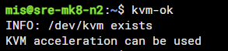
Linux KVM
$ sudo apt update
$ sudo apt install cpu-checker
$ kvm-ok
$ grep –E "(vmx|svm)" /proc/cpuinfo
my-ubuntu-pc001
Check if your CPU supports HW Virtualization.
vmx: Indicates Intel VT-x hardware virtualization support.
svm: Indicates AMD SVM (Secure Virtual Machine) hardware virtualization support.
1. Installing required packages for QEMU/KVM
$ sudo apt install qemu-system-x86 qemu-utils libvirt-daemon-system virt-manager -y
$ sudo systemctl enable --now libvirtd
2. Downloading a Lightweight ISO
$ wget http://tinycorelinux.net/14.x/x86_64/release/TinyCorePure64-current.iso -O tinycore.iso
Notes:
Try using laptop and TeamViewer to give demo, Using my test Ubuntu machine didn’t work to boot iso. Use small VM with GUI.
Connect to remote Ubuntu Desktop via Web TeamViewer (https://web.teamviewer.com/) and show the commands and run the instance

Slide 24
Linux KVM
Short Demo
3. Create a Virtual Disk for VM
Access to Ubuntu running on remote laptop to run Qemu
$ qemu-img create -f qcow2 tinycore.qcow2 1G
Create a 1 GB virtual disk using qemu-img
4. Run the VM with QEMU/KVM
$ qemu-system-x86_64 -enable-kvm -m 512 -cdrom tinycore.iso -hda tinycore.qcow2 -boot d
enable-kvm: Enables hardware virtualization.
m 512: Allocates 512 MB RAM to the VM.
cdrom tinycore.iso: Boots the ISO file as a live CD.
hda tinycore.qcow2: Uses the virtual disk created earlier.
5. See the list of running VMs
$ ps aux | grep qemu-system
Notes:
Try using laptop and TeamViewer to give demo, Using my test Ubuntu machine didn’t work to boot iso. Use small VM with GUI.
Connect to remote Ubuntu Desktop via Web TeamViewer (https://web.teamviewer.com/) and show the commands and run the instance

Slide 25

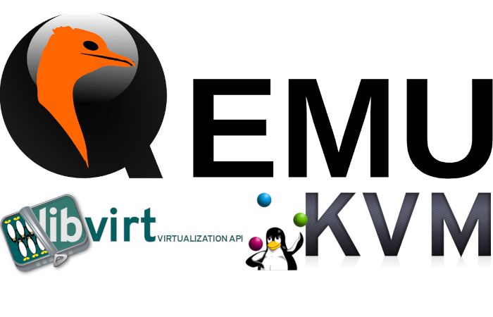
Virsh (Virtual Shell)
Virsh is a command-line interface for managing VMs that are handled by the libvirt library. It acts as a management layer on top of KVM, QEMU, or other hypervisors.
Virsh communicates with the libvirt daemon (libvirtd), which interfaces with virtualization back-ends like KVM/QEMU, or LXC. It provides a higher-level, user-friendly way to manage VMs.
KEY FEATURES
Manage VMs: start, stop, list, pause, destroy.
Define virtual machines via XML configuration files.
Connect to remote hypervisors.
Works with multiple hypervisors (KVM/QEMU, VMware ESXi, etc.).
Provides more granular control of VMs and their resources.

Slide 26
Virsh (Virtual Shell)
Examples
$ virsh list --all # List all virtual machines
$ sudo virsh define vm.xml # Define a VM from an XML file
$ sudo virsh undefine vm_name # Undefine a VM from an XML file
$ sudo virsh start my-vm # Start the VM named 'my-vm'
$ sudo virsh shutdown my-vm # Shut down the VM
$ sudo virsh destroy my-vm # Forcefully shut down the VM
How KVM/QEMU/Libvirt/Virsh work together?
KVM provides the virtualization capabilities.
QEMU is often used alongside KVM to create and run VMs.
Libvirt provides a management layer for hypervisors like KVM.
Virsh is a CLI that allows users to interact with libvirt to manage KVM-based VMs.
Notes:
SSH to laptop and show how Virsh command works (no need to use Team Viewer here).

Slide 27
Virsh (Virtual Shell)
vm-config.xml
<domain type='kvm'>
<name>my-vm</name>
<memory unit='MiB'>1024</memory>
<vcpu>1</vcpu>
<os>
<type arch='x86_64'>hvm</type>
</os>
<devices>
<disk type='file' device='disk'>
<source file='/var/lib/libvirt/images/my-vm.qcow2'/>
<target dev='vda' bus='virtio'/>
</disk>
<interface type='network'>
<source network='default'/>
</interface>
<graphics type='vnc' port='-1' autoport='yes'/>
<console type='pty'>
<target type='serial' port='0'/>
</console>
</devices>
</domain>
https://libvirt.org/formatdomain.html
Notes:
SSH to laptop and show how Virsh command works (no need to use Team Viewer here).

Slide 28

KVM vs Virsh (Virtual Shell)
 | KVM | Virsh
Type | Low-level kernel virtualization module | High-level CLI management tool
Role | Provides HW-accelerated virtualization | Manages VMs via libvirt
Interface | No direct CLI; requires QEMU to interact | Command-line tool for managing VMs
Dependency | Part of the Linux kernel | Depends on the libvirt library
Hypervisors | KVM is specific to Linux kernel | Supports multiple Hypervisors (KVM)
VM MGMT | Requires tools like QEMU to manage VMs | Provides commands to define/start/stop VMs
Example | qemu-system-x86_64 -enable-kvm ... | virsh start my-vm

Slide 29
Short Demo (Virsh)
$ nano alpine.xml
$ sudo virsh define alpine.xml $ sudo virsh start alpine-vm $ sudo virsh shutdown alpine-vm $ virsh list --all
$ sudo virsh reboot alpine-vm $ sudo virsh destroy alpine-vm
$ sudo virsh start alpine-vm $ sudo virsh console alpine-vm
$ sudo virsh net-edit default $ sudo virsh net-destroy default $ sudo virsh net-start default
Notes:
ssh directly to the host (192.168.1.100) from putty to run virsh command

Slide 30
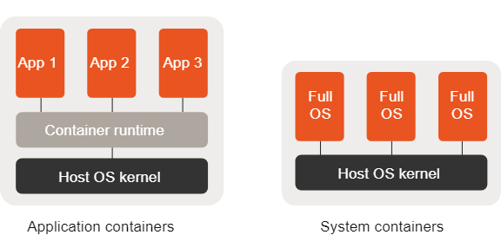
Types of Linux Containers
Application (process) Containers
The main idea is one application per container, in some cases one process per container
A container root file system has only necessary Linux distribution-specific binaries and application binaries
Applications have to be “cloud-native” - different tooling and approaches have to be used
Mainly non-persistent rootfs, e.g. AUFS or overlayfs, persistence is achieved via other mounted file systems (ephemeral).
Example: Docker containers
System (machine) Containers
Similar to virtual machines - lightweight “logical machines”
Multiple processes per container
No need to convert classic user space applications to run them in containers
Persistent storage (ext4, zfs) for rootfs
Example: LXC & LXD, OpenVZ.

Slide 31
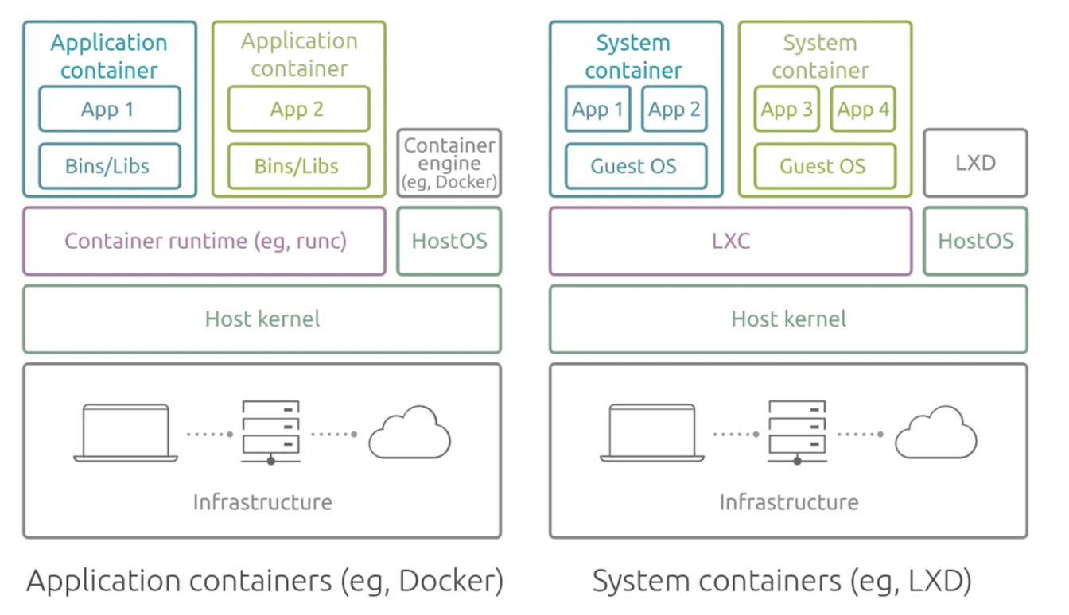
Application Container vs System Container

Slide 32
LXC & LXD (LinuX Containers & LinuX Daemon)
LXC: Lightweight Containers
Enables us to run applications or full Linux distributions in isolated environments without the overhead of full virtualization.
OS-level virtualization.
Containers share the host kernel but run in isolated user spaces.
Fast startup times and low resource overhead.
Ideal for testing or running micro-services.
LXD: A System Container Manager
LXD is a container manager built on top of LXC, designed to provide a simple and easy-to-use interface for managing system containers.
Provides higher-level management features like live migration/snapshots/cloning.
Can manage both containers and virtual machines (using QEMU/KVM).
Supports multi-architecture virtual machines (e.g., x86, ARM).
REST API available for automation and cloud management.
https://documentation.ubuntu.com/lxd/en/latest/explanation/lxd_lxc/
https://canonical.com/lxd

Slide 33

LXD & LXC (LinuX Daemon & LinuX Containers)
LXC (Linux Containers) use No Hypervisor:
LXC is not a virtualization technology in the traditional sense, indeed it is a low-level user space interface that uses Linux kernel features such as namespaces to isolate processes. This means containers share the host kernel, eliminating the need for a hypervisor. Indeed, LXC containers are more lightweight because they directly utilize the Linux kernel without requiring hardware emulation or kernel virtualization.
LXD (Linux Daemon)
Similar to LXC, LXD also manages system containers using Linux kernel features (e.g., namespaces, cgroups) and does not rely on a hypervisor for this purpose. LXD is a more intuitive and user-friendly tool aimed at making it easy to work with Linux containers. When LXD is used to run VMs, it relies on QEMU as the underlying hypervisor to provide full hardware virtualization. QEMU works alongside the KVM on Linux systems to enable efficient virtualization with near-native performance.
For Containers, LXD and LXC rely on the Linux kernel, not a Hypervisor.
For VMs (via LXD), LXD uses QEMU with KVM as the hypervisor for HW virtualization.
Under the hood, LXD uses LXC to create and manage the containers. LXD provides a superset of the features that LXC supports, and it is easier to use.

Slide 34
LXD & LXC (LinuX Daemon & LinuX Containers)
LXD uses LXC for system containers:
LXC is the technology allowing the segmentation of your system into independent containers, whereas LXD is a daemon running on top of LXC which facilitates the creation and management of system containers.
LXD uses QEMU for VMs (need KVM support on Host):
LXD integrates with QEMU for running VMs, allowing it to manage both containers and VMs in a unified environment.
LXC and LXD Roles:
LXC provides the low-level containerization technology, while LXD offers a daemon and a user-friendly interface for managing those containers with additional features.
LXD's features (storage, networking, logging):
LXD supports various storage back-ends, networking configurations, and logging mechanisms, making it highly flexible for a range of use cases.
Image-based and workload flexibility:
LXD leverages image-based deployment, allowing for diverse workloads, from lightweight containerized systems to heavier traditional applications.
While LXD shares similarities in managing workloads, it is much more resource-efficient (in comparison to VMware or other technologies) and avoids virtualization overhead, as it uses system containers for many tasks.
Notes:
LXC is the technology allowing the segmentation of your system into independent containers, whereas LXD is a daemon running on top of LXC allowing you to manage and operate these instances in an easy and unified way.

Slide 35
LXD & LXC (LinuX Daemon & LinuX Containers)
LXD daemon
The lxd command controls the LXD daemon. Since the daemon is typically started automatically, you hardly ever need to use the lxd command.
LXD client
The lxc command is a command-line client for LXD, which you can use to interact with the LXD daemon. You use the lxc command to manage your instances, the server settings, and overall the entities you create in LXD.
$ lxd init - -auto
$ lxc image list ubuntu: # ubuntu: is officially supported image source
$ lxc image list images: # images: is an unsupported source
$ lxc launch ubuntu:22.04 my_container # using - - vm you can launch a VM but need KVM support on the host.
$ lxc launch images:alpine/edge alpine-container # install latest available Alpine image
$ lxc delete alpine-container [- -force] # - -force if it is running
$ lxc copy CONTAINER1 CONTAINER2 # clone
$ lxc list
$ lxc start alpine-container
$ lxc stop alpine-container [- -force] # - -force if it doesn't want to stop
$ lxc restart alpine-container [- -force]
$ lxc pause alpine-container # STOP to all container processes
$ lxc exec alpine-container - - /bin/sh # access the container via a BASH shell
$ lxc console alpine-container # access VM via console
https://documentation.ubuntu.com/lxd/en/latest/explanation/lxd_lxc/
https://canonical.com/lxd
Notes:
Use WSL2 to show the class (no web TeamViewer)

Slide 36

Comparison
Feature | VMware | LXC/LXD | KVM/QEMU
Type of Virtualization | Full hardware virtualization | OS-level virtualization (Containers) | Full hardware virtualization (with KVM)
Overhead | High (due to full VM environment) | Low (containers share the host kernel) | Medium (with hardware acceleration)
Performance | Excellent for heavy workloads | Very fast for containerized workloads | High, depending on the configuration
Use Case | Enterprise, cross-platform workloads | Lightweight app deployment, system containers | Full VMs with access to hardware resources
Resource Efficiency | Moderate to high | Very high (containers share kernel) | Moderate (with KVM hardware acceleration)
Ease of Use | GUI-based, user-friendly | CLI-based or LXD GUI, more complex | CLI-based, or using management tools (virt-manager)

Slide 37
LXD & LXC (LinuX Daemon & LinuX Containers)
Interactive Demo
&
2
Notes:
Students can walk through the commands shown in two slides ago.

Slide 38
Lecture #3 Summary
Know how to use Docker Compose and YAML language.
Explaining the difference between App and Sys Containers.
Getting familiar with some of the most popular open source virtualization tools, e.g., KVM/Qemu/Virsh/LXC
Utilizing the introduced tools to build VMs and containers, and manage their resources

Slide 39
Review of LAB #2

Slide 40

End of Lecture #3
THANK Y☺U
- Dawood Sajjadi
Notes:
Provide some cheat sheets and references for these three subjects and ask students to install them on their PCs.

